Slide 1

Owl chat
MALEEHA SHEIKH-15
FARHANA NOWSHEEN-05
ABDULLAH AL NAKIB-01
#1+5=15
POWERED BY MAGIC

Slide 2
OUR SERVICES
ONE TO ONE CHAT
GROUP CHAT
FILE SHARING

Slide 3
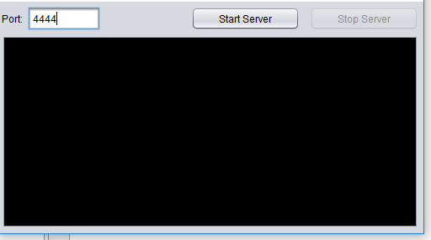
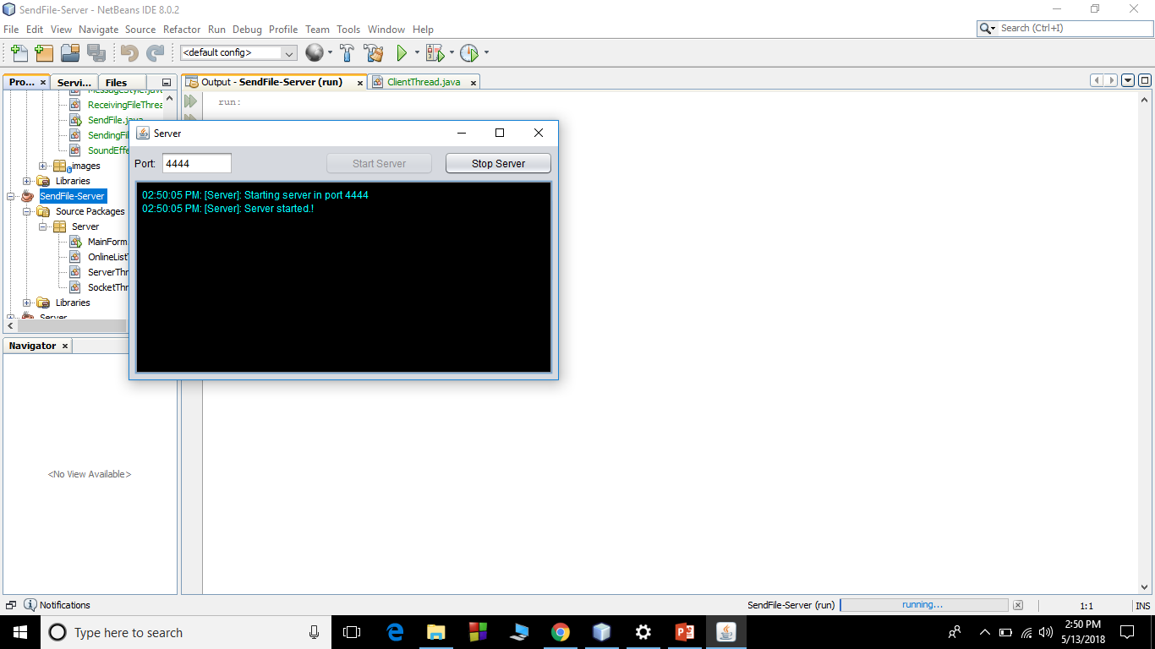
SERVER LAYOUT
BEFORE STARTING SERVER
AFTER STARTING SERVER

Slide 4
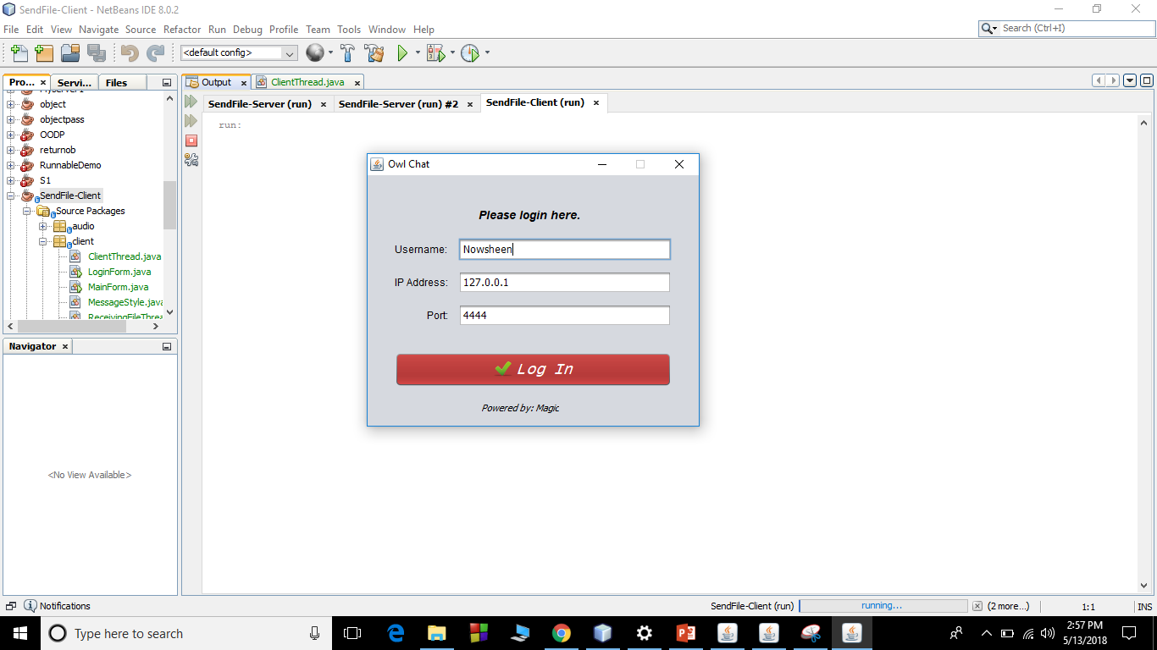
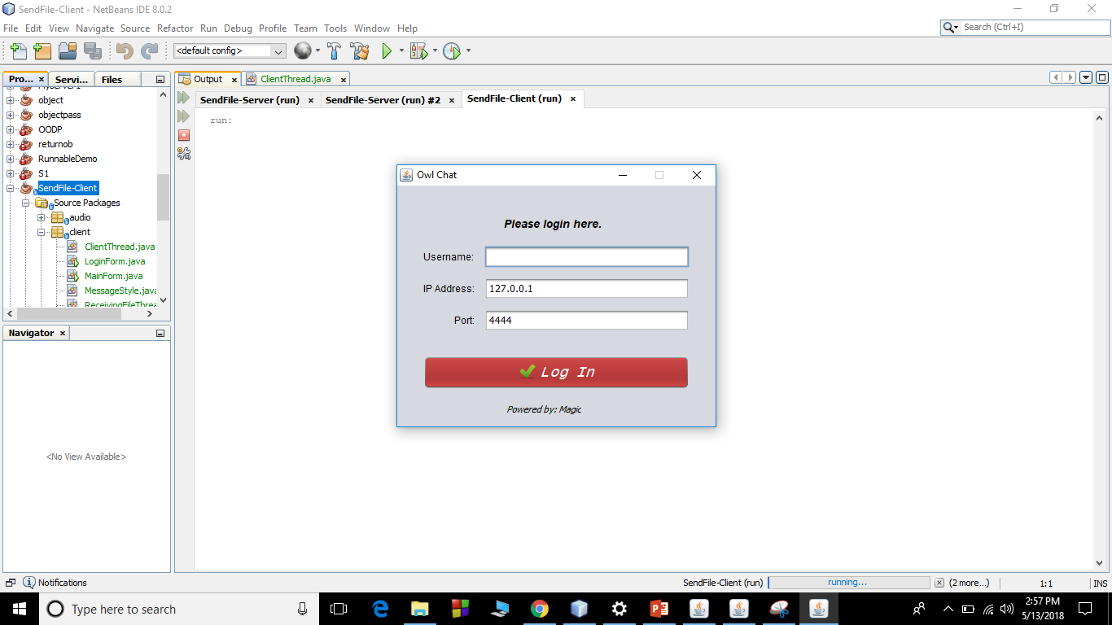
CLIENT LAYOUT
Log in form

Slide 5
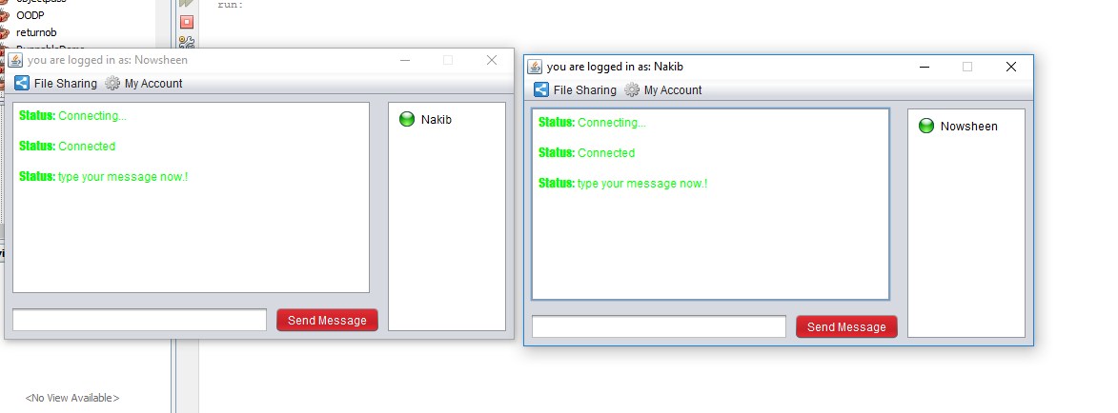
ONE TO ONE CHAT
CHAT WINDOW

Slide 6
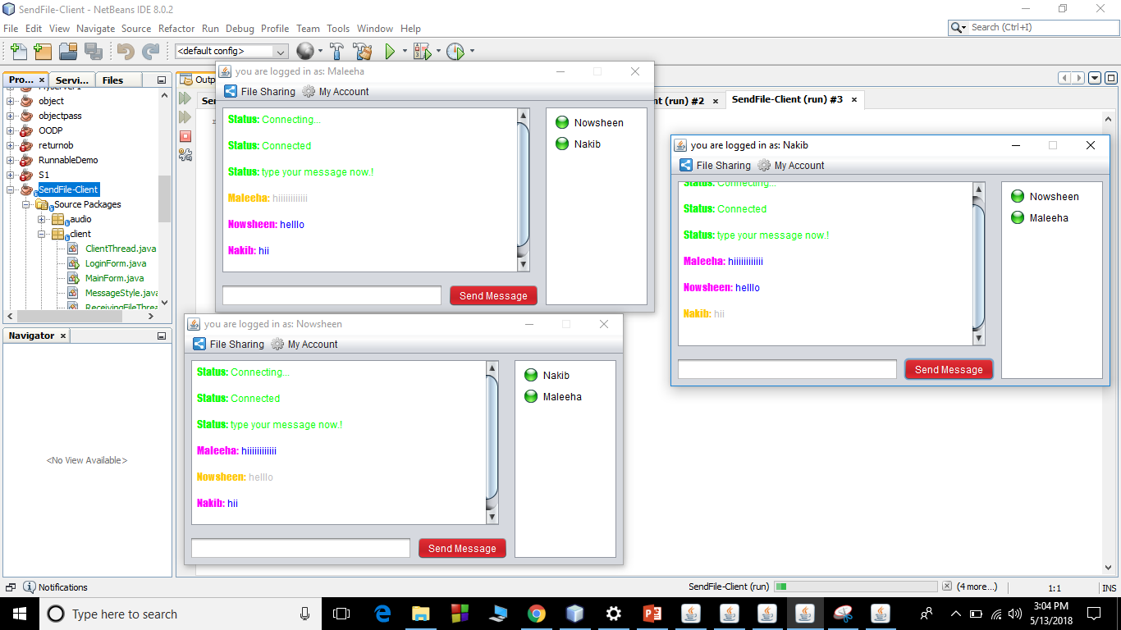
GROUP CHAT

Slide 7

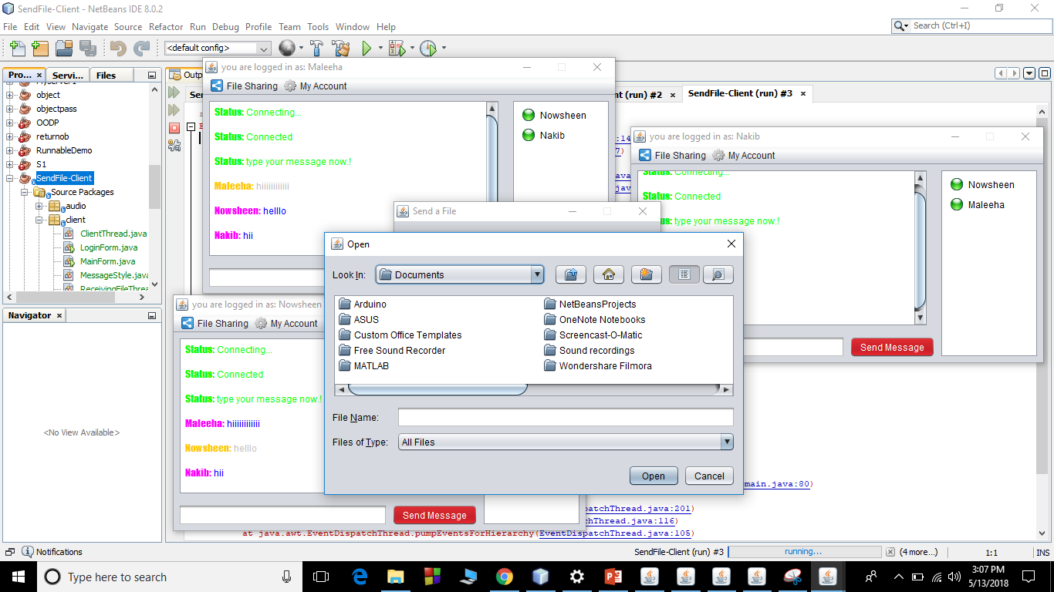
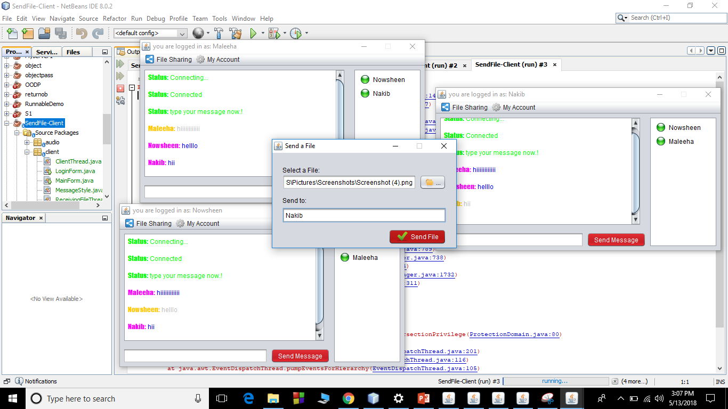
FILE SHARING

Slide 8

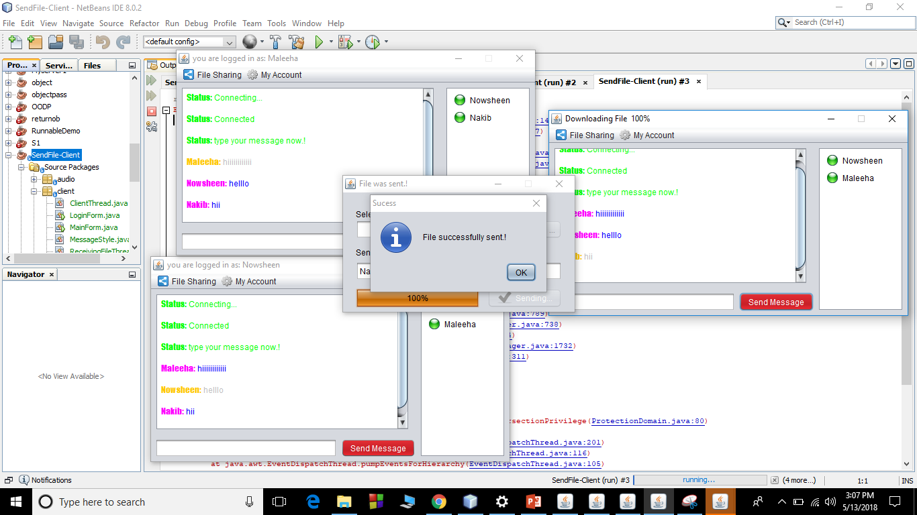
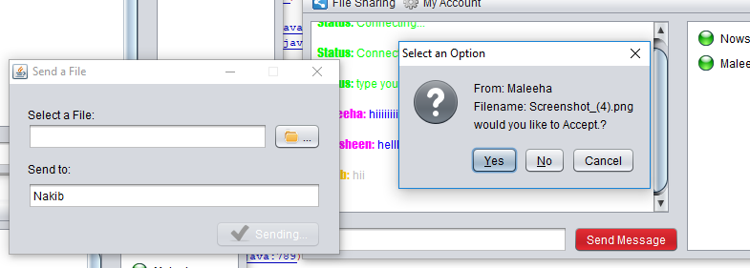
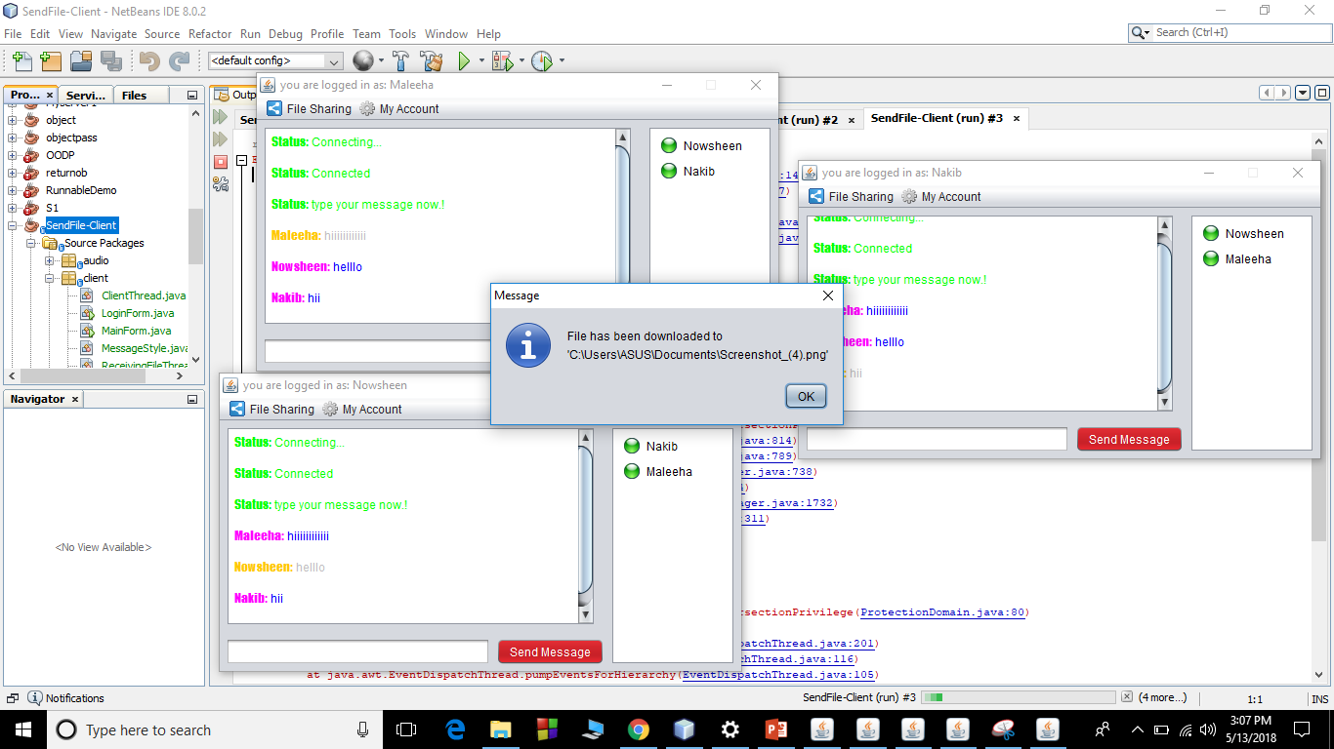
FILE SHARING

Slide 9
THANK YOU
-------Happy Owling

